Slide 1
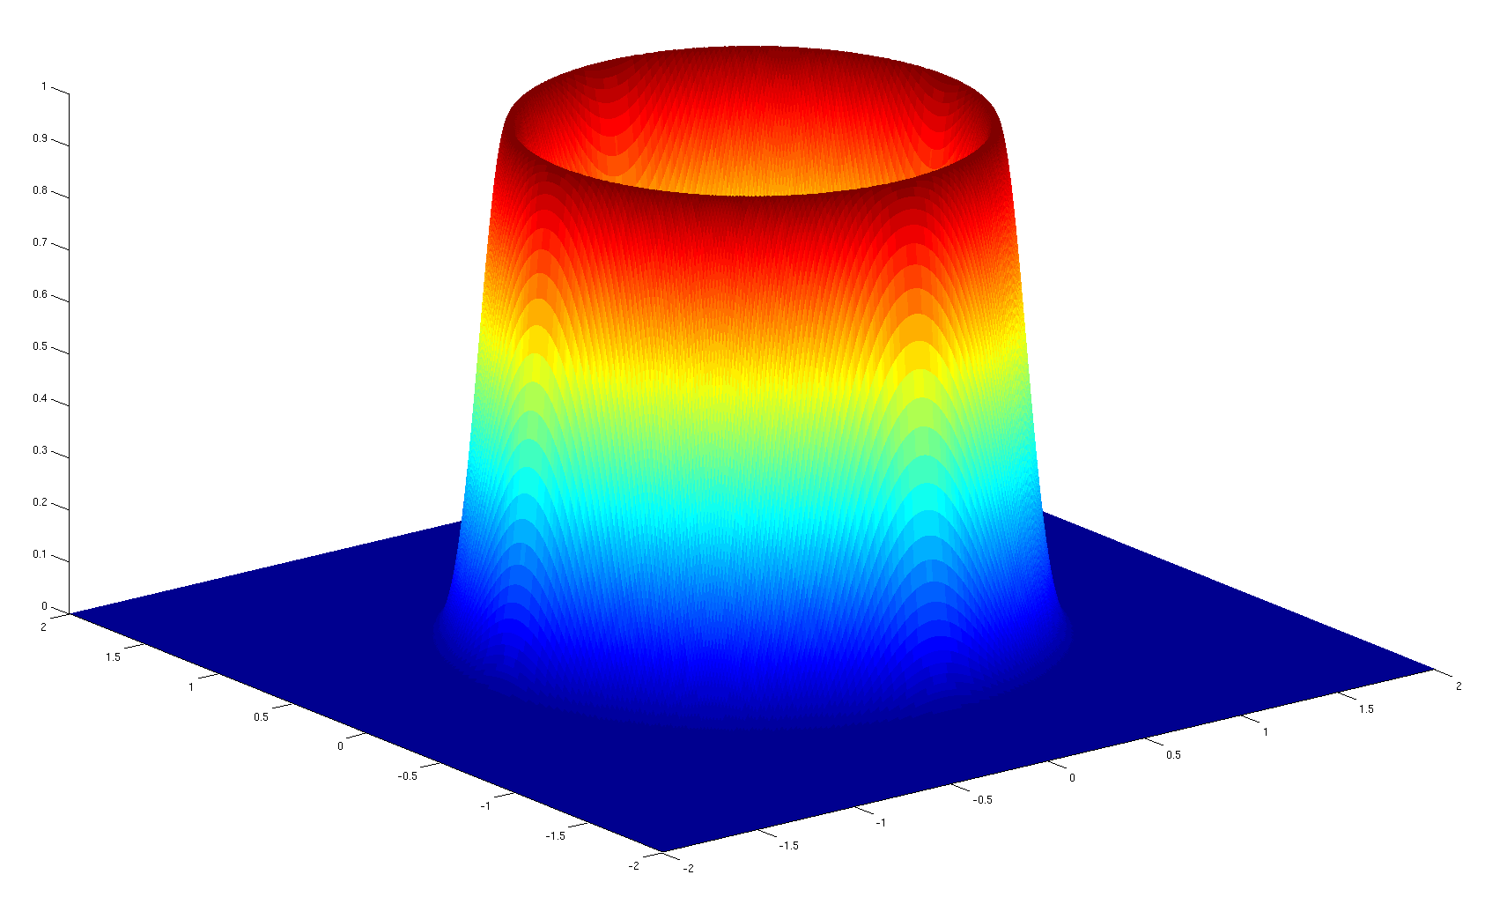
Gaussian Processes to Speed up Hamiltonian Monte Carlo
Matthieu Lê
Murray, Iain http://videolectures.net/mlss09uk_murray_mcmc/
Rasmussen, Carl Edward. "Gaussian processes to speed up hybrid Monte Carlo for expensive Bayesian integrals." Bayesian Statistics 7: Proceedings of the 7th Valencia International Meeting. Oxford University Press, 2003.
Neal, Radford M (2011). " MCMC Using Hamiltonian Dynamics. " In Steve Brooks, Andrew Gelman, Galin L. Jones, and Xiao-Li Meng. Handbook of Markov Chain Monte Carlo. Chapman and Hall/CRC.

Slide 2

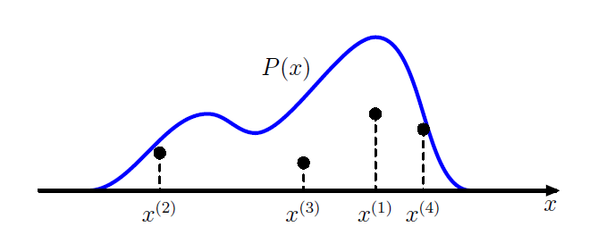
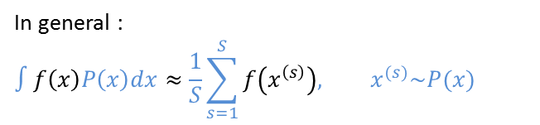
MCMC
  Monte Carlo : Rejection sampling, Importance sampling, …
MCMC : Markov Chain Monte Carlo
Sampling technique to estimate a probability distribution
Draw samples from complex probability distributions
In general :
$$∫f\left(x\right)P\left(x\right)dx≈\frac{1}{S}\sum_{s=1}^{S}{f\left(x^{\left(s\right)}\right), x^{(s)}\sim P(x)}$$

Slide 3


Objective
Bayesian Inference :
$θ$ : Model parameter
$x_{i}$ : Observations
$$P\left(θ | x_{1} …x_{n}\right)= \frac{P\left(x_{1} …x_{n} | θ\right)P\left(θ\right)}{\int{P\left(x_{1} …x_{n} | θ\right)P\left(θ\right)dθ}}$$
$$P\left(θ | x_{1} …x_{n}\right)=\frac{1}{Z} P\left(x_{1} …x_{n} | θ\right)P\left(θ\right)$$
MCMC : sample $P\left(θ | x_{1} …x_{n}\right)$ without the knowledge of $Z$
$P\left(θ\right)$ : prior on the model parameters
$P\left(x_{1} …x_{n} | θ\right)$ : likelyhood, potentially expensive to evaluate

Slide 4
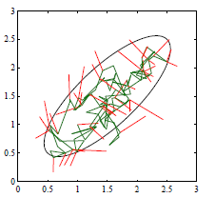
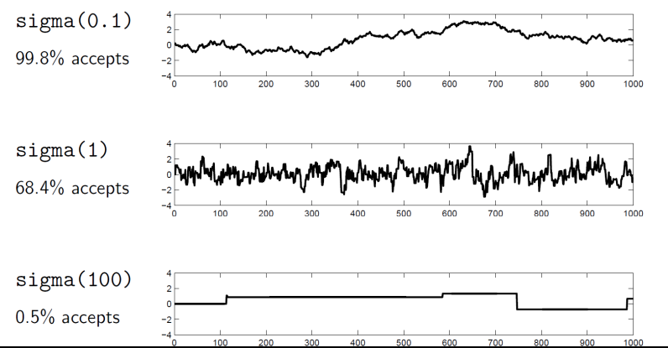
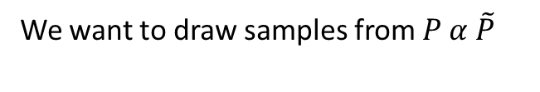
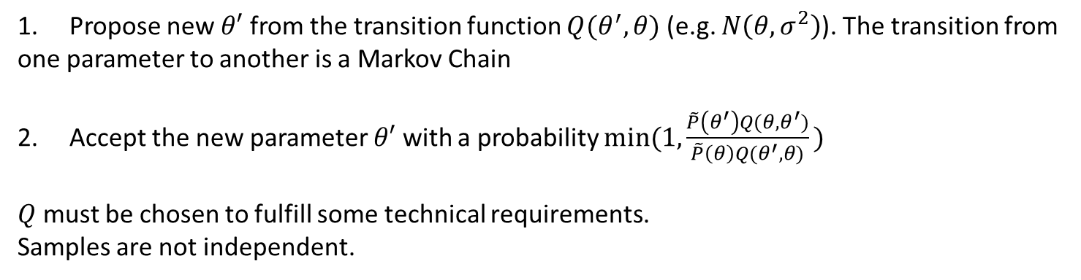

Metropolis-Hastings
We want to draw samples from $P α \tilde{P}$
1. Propose new $θ′$ from the transition function $Q(θ^{′},θ)$ (e.g. $N\left(θ,σ^{2}\right)$). The transition from one parameter to another is a Markov Chain
2. Accept the new parameter $θ′$ with a probability $min⁡(1,\frac{\tilde{P}\left(θ^{′}\right)Q(θ,θ^{′})}{\tilde{P}\left(θ\right)Q(θ^{′},θ)}\text{)}$
$Q$ must be chosen to fulfill some technical requirements.
Samples are not independent.
Sample $N\left(0,1 \right)$)

Slide 5
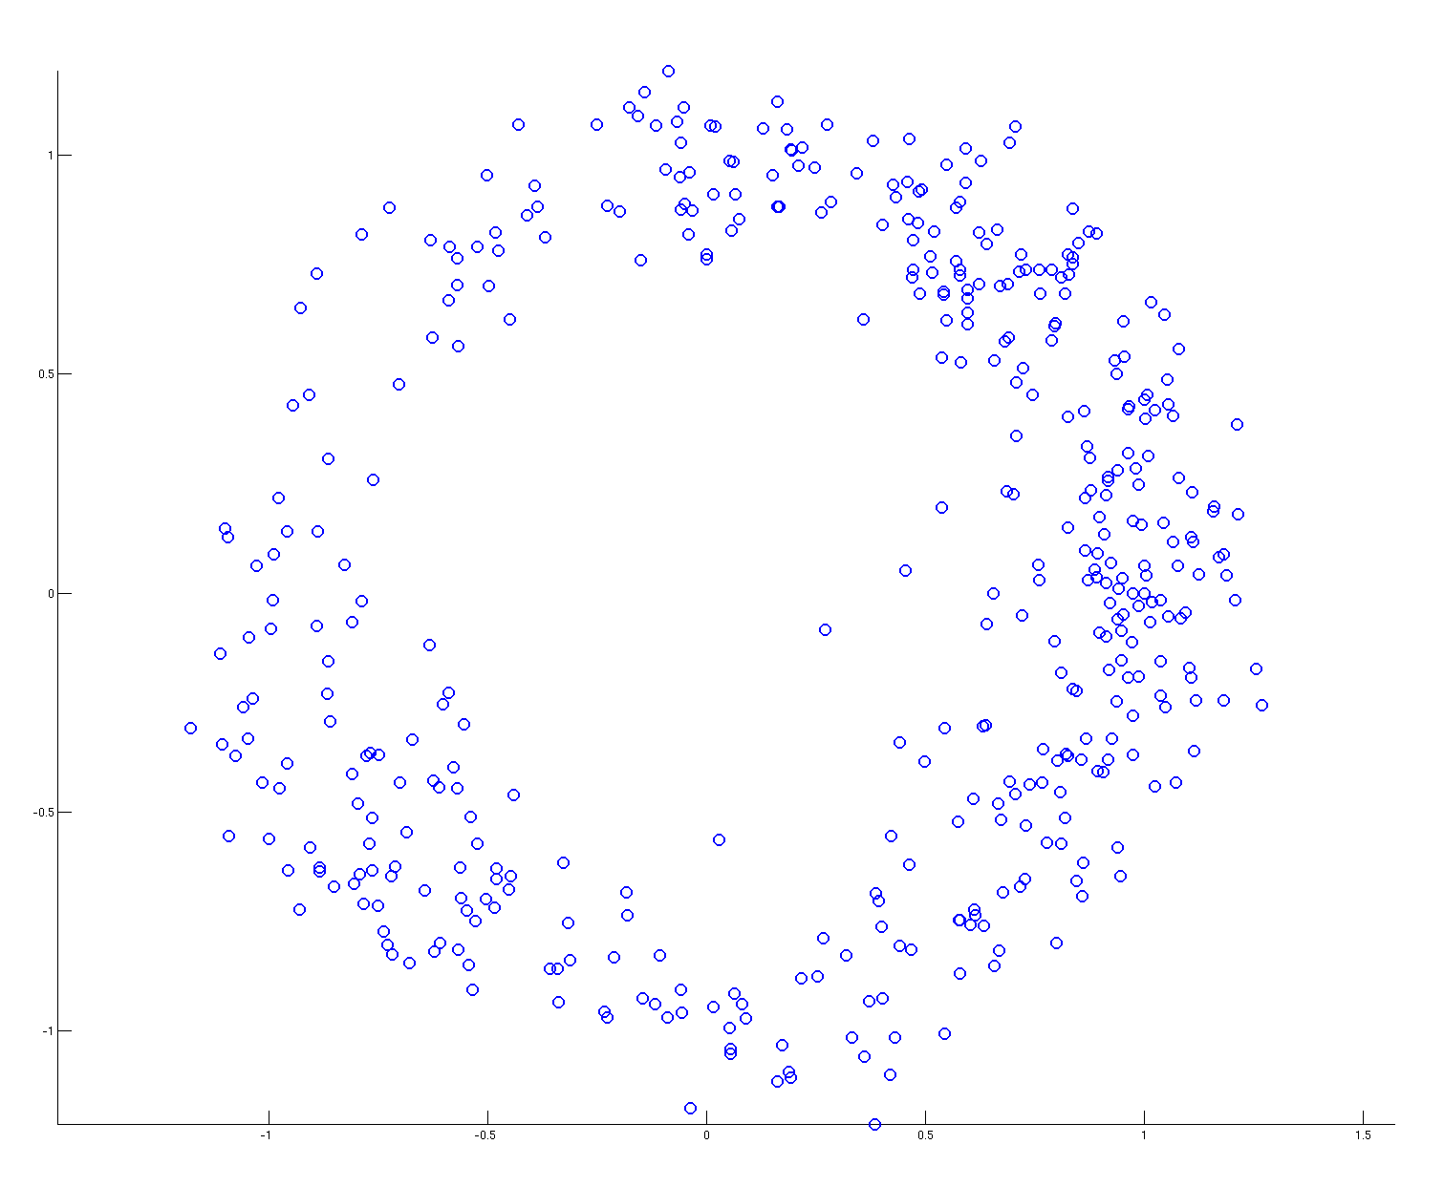
Metropolis-Hastings
Metropolis-Hastings: 1000 samples, step 0.1
Rejection rate: 44%
Problem : The proposed samples come from a Gaussian. There is possibly an important rejection rate.

Slide 6






Hamiltonian Monte Carlo
Same idea as Metropolis-Hastings BUT the proposed samples now come from the Hamiltonian dynamics :
$$H=E_{pot}+E_{kin}$$
$${ E}_{pot}=−\log\left(P\left(θ\right)\right), E_{kin}=\frac{p^{2}}{2m}$$
$$\frac{∂θ}{∂t}= \frac{∂E_{kin}}{∂p}= \frac{p}{m}$$
$$\frac{∂p}{∂t}=−\frac{∂E_{pot}}{∂θ}$$
$$θ$$
$$θ^{∗}$$
$$\vec{p}$$
$$\vec{p^{∗}}$$

Slide 7

Hamiltonian Monte Carlo
Algorithm :
Sample $p$ according to its known distribution
Run the Hamiltonian dynamics during a time T
Accept the new sample with probability :
$$min⁡(1,\exp\left(−E_{pot}^{∗}+E_{pot}\right)exp⁡(−E_{kin}^{∗}+E_{kin}))$$
The Energy is conserved so the acceptance probability should theoretically be 1.
Because of the numerical precision, we need the Metropolis-Hastings type decision in the end.

Slide 8
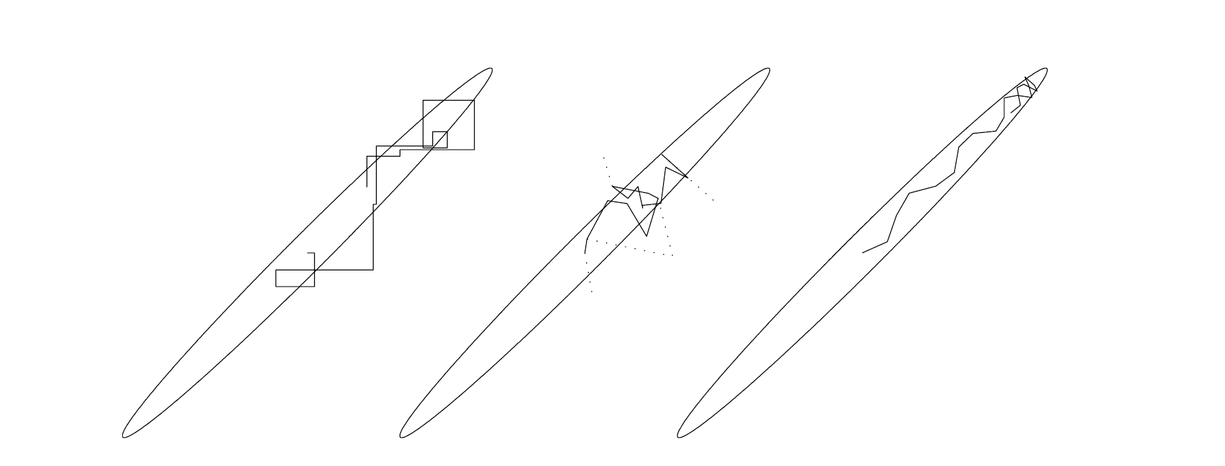
Hamiltonian Monte Carlo
Gibbs Sampling
Metropolis-Hastings
Hamiltonian Monte Carlo

Slide 9
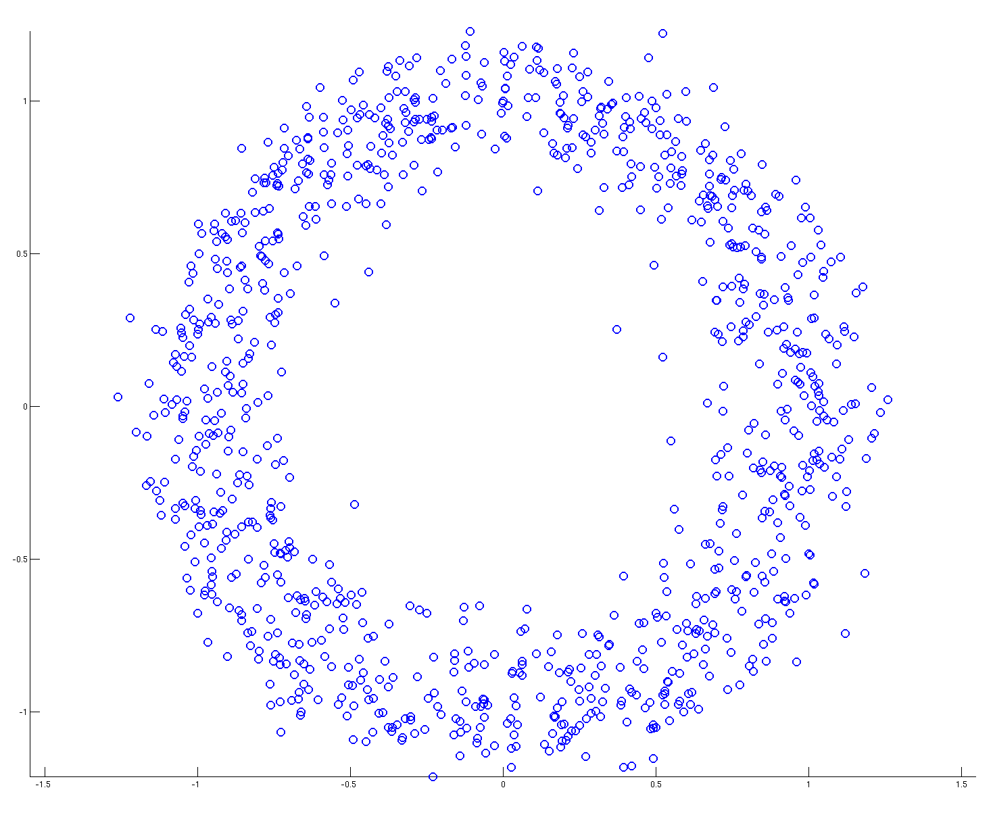
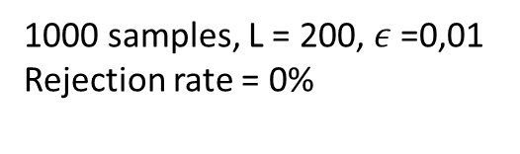
Hamiltonian Monte Carlo
Advantage : The Hamiltonian stays (approximately) constant during the dynamic, hence lower rejection rate !
1000 samples, L = 200, $ε$ =0,01
Rejection rate = 0%
Problem : Computing the Hamiltonian dynamic requires computing the model partial derivatives, high number of simulation evaluation !
Neal, Radford M (2011). " MCMC Using Hamiltonian Dynamics. " In Steve Brooks, Andrew Gelman, Galin L. Jones, and Xiao-Li Meng. Handbook of Markov Chain Monte Carlo. Chapman and Hall/CRC.

Slide 10
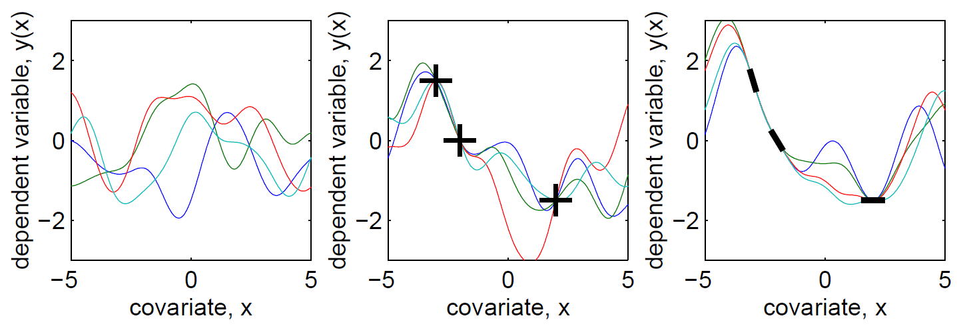
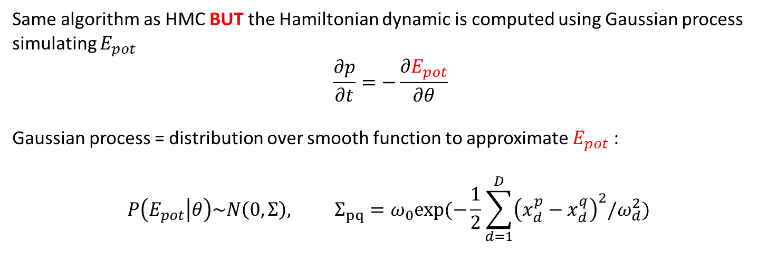
Gaussian Process HMC
Same algorithm as HMC BUT the Hamiltonian dynamic is computed using Gaussian process simulating $E_{pot}$
$$\frac{∂p}{∂t}=−\frac{∂E_{pot}}{∂θ}$$
Gaussian process = distribution over smooth function to approximate $E_{pot}$ :
$$P\left(E_{pot} | θ\right)\sim N\left(0,Σ\right), Σ_{pq}=ω_{0}exp(−\frac{1}{2}\sum_{d=1}^{D}{{\left(x_{d}^{p}−x_{d}^{q}\right)}^{2}/ω_{d}^{2}})$$

Slide 11

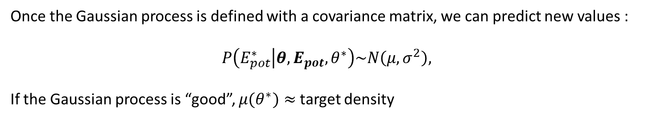
Gaussian Process HMC
Once the Gaussian process is defined with a covariance matrix, we can predict new values :
$$P\left(E_{pot}^{∗} | θ, E_{pot}, θ^{∗}\right)\sim N\left(μ,σ^{2}\right),$$
If the Gaussian process is “good”, $μ(θ^{∗})≈$target density
Algorithm :
Initialization :
  Evaluate the target density at D random points to define the Gaussian process.
Exploratory phase :
  HMC with $E_{pot}=μ−σ$ : evaluation of points with high target value and high uncertainty. Evaluate the real target density at the end of each iteration.
Sampling phase :
  HMC with $E_{pot}=μ$.

Slide 12
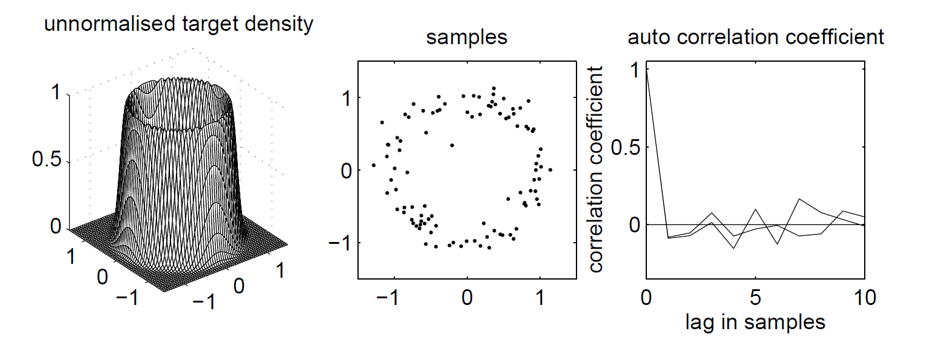
Gaussian Process HMC
Rasmussen, Carl Edward. "Gaussian processes to speed up hybrid Monte Carlo for expensive Bayesian integrals." Bayesian Statistics 7: Proceedings of the 7th Valencia International Meeting. Oxford University Press, 2003.

Slide 13
Conclusion
Metropolis-Hastings : few model evaluation per iteration but important rejection rate
Hamiltonian Monte Carlo : a lot of model evaluation per iteration but low rejection rate
GPHMC : few model evaluation per iteration and low rejection rate
  BUT : Initialization requires model evaluations to define a “good” Gaussian process
  BUT : Exploratory phase requires one model evaluation per iteration

Slide 14


