Slide 1
Marked Point Process Model for Curvilinear Structures Extraction
AYIN research team
INRIA Sophia-Antipolis Méditerranée
Seong-Gyun JEONG, Yuliya TARABALKA, and Josiane ZERUBIA
firstname.lastname@inria.fr
https://team.inria.fr/ayin/
Notes:
Draft version for vision seminar (@inria) 15.Oct. 2014

Slide 2
Outline
Introduction
Marked Point Process modeling
MPP revisited
Generic model for curvilinear structures
Monte Carlo sampler with delayed rejection
Integration of line hypotheses
Experimental results
Summary

Slide 3
Outline
Introduction
Marked Point Process modeling
MPP revisited
Generic model for curvilinear structures
Monte Carlo sampler with delayed rejection
Integration of line hypotheses
Experimental results
Summary

Slide 4

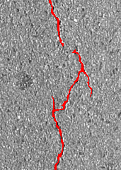

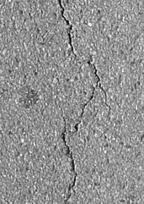
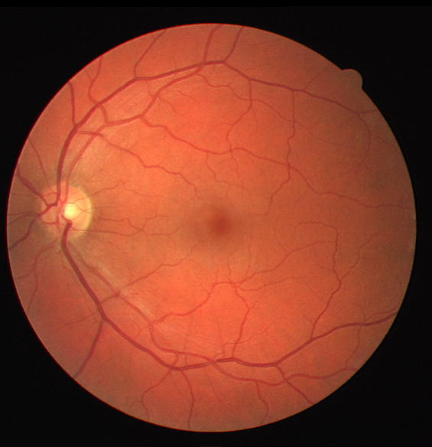
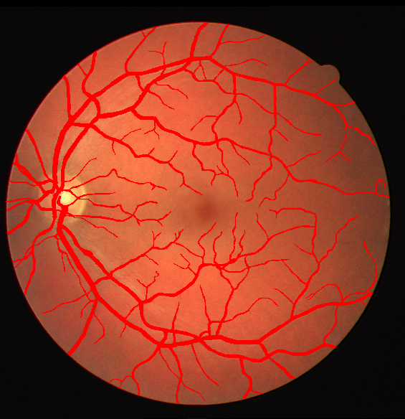
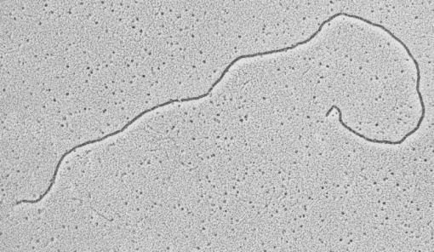
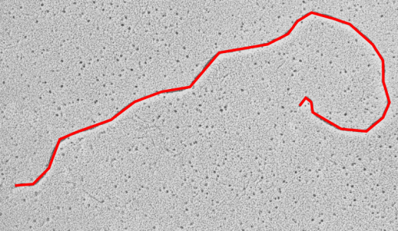
Curvilinear Structure
Goal: detection + localization of curvilinear structures: wrinkles, road cracks, blood vessels, DNA, ...

Slide 5
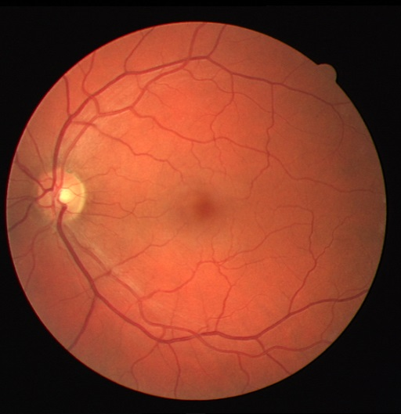
Challenges
Low contrast within a homogeneous texture
Shown in a complex shape

Slide 6
Outline
Introduction
Marked Point Process modeling
MPP revisited
Generic model for curvilinear structures
Monte Carlo sampler with delayed rejection
Integration of line hypotheses
Experimental results
Summary

Slide 7
Marked Point Process
Counting unknown number of objects with higher order shape constraints
Three essentials to realize MPP model:
Parametric object
Probability density
Sampler

Slide 8






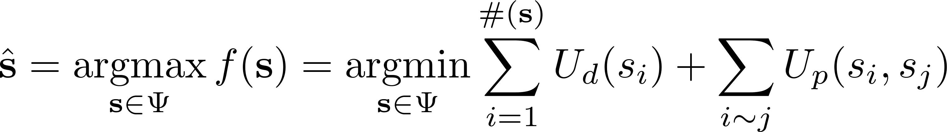
Marked Point Process
Parametric object
Point (Image site) + Mark (Object shape):
e.g.,
Probability density
Defines distribution of points
Circle
Ellipse
Rectangle
Line
tree
boat
building
road
Data likelihood
Prior energy

Slide 9


Marked Point Process
Sampler
Goal: maximize unnormalized probability density over configuration space
Difficulties:
is non-convex
’s dimensionality is unknown
MCMC sampler
Each state of a discrete Markov chain corresponds to a random configuration on
The Markov chain is locally perturbed by sub-transition kernels and converges toward stationary state

Slide 10
Outline
Introduction
Marked Point Process modeling
MPP revisited
Generic model for curvilinear structures
Monte Carlo sampler with delayed rejection
Integration of line hypotheses
Experimental results
Summary

Slide 11
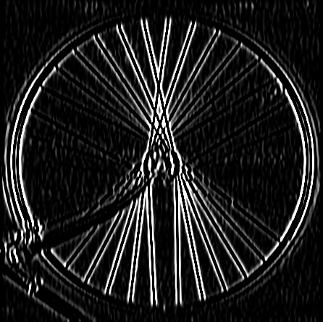
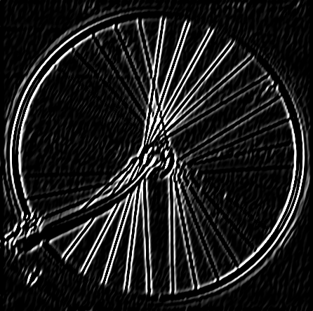
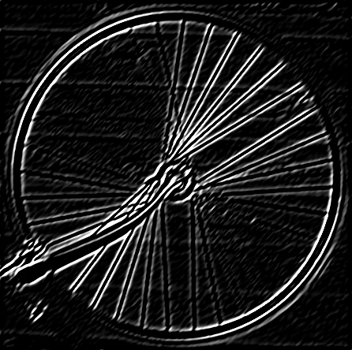
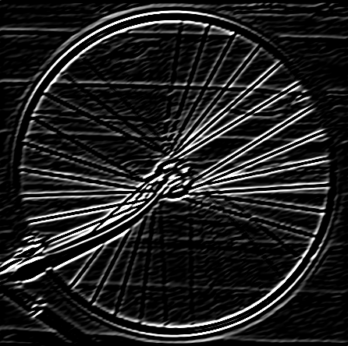
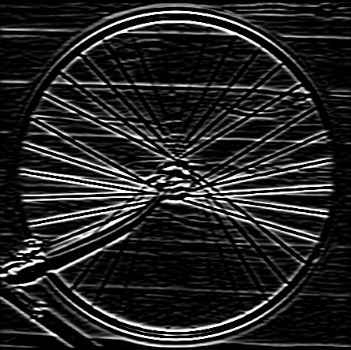
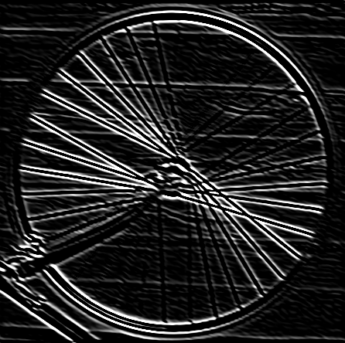
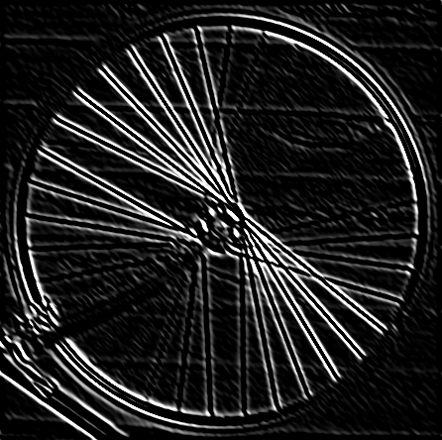
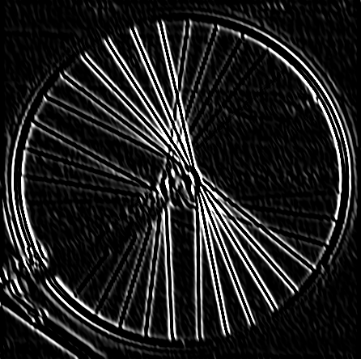
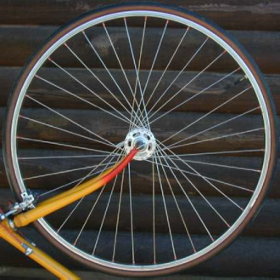
Data Likelihood
Features for curvilinear structure
Gradient magnitude
Homogeneity of pixel values
Steerable filters
Linear combination of 2nd derivatives of Gaussian
Accentuate gradient magnitudes w.r.t. orientation
Gradient magnitude
Intensity variance
Input
Filtering responses

Slide 12






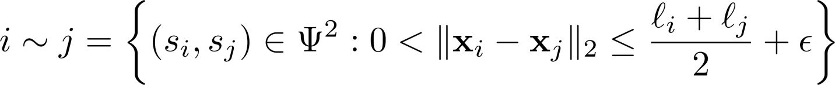
Prior Energy
Spatial interactions on a local configuration
Neighborhood system
Pairs of line segments, s.t. their center distance is smaller than half the sum of their lengths
aligned lines
perpendicular
adjacent
parallel
overlap
acute corner
Preferable
Undesirable

Slide 13


Prior Energy
Intersection
To avoid congestion in a local configuration
Dilate line segments
Count the number of pixels falling in the same area
Reject configurations if portion of intersection areas ≥ 10%
Intersection
Coupling energies
parallel
overlap
acute corner

Slide 14

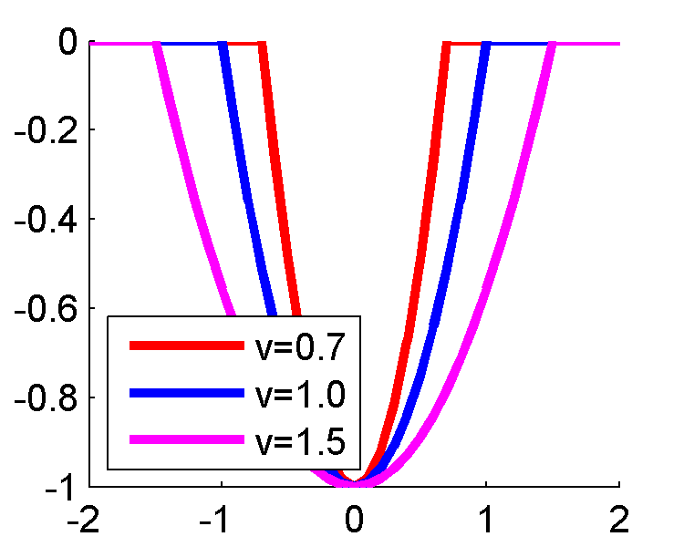
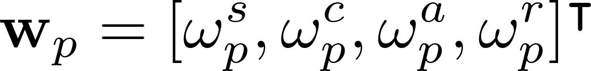




Prior Energy
Coupling energies
To obtain smoothly connected lines
penalizes single line segment
minimizes gap between lines
prefers small curvature
allows almost perpendicular lines
Intersection
Coupling energies

Slide 15
Outline
Introduction
Marked Point Process modeling
MPP revisited
Generic model for curvilinear structures
Monte Carlo sampler with delayed rejection
Integration of line hypotheses
Experimental results
Summary

Slide 16

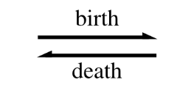


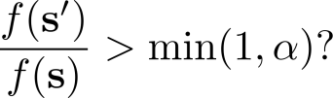
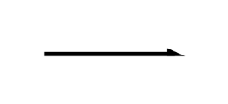

RJMCMC
Stimulate a discrete Markov chain over the configuration space via sub-transition kernels
Birth kernel proposes a new segment
Death kernel removes a segment
Affine transform updates intrinsic variables of the segment

Slide 17
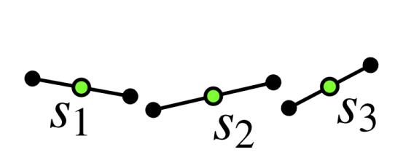
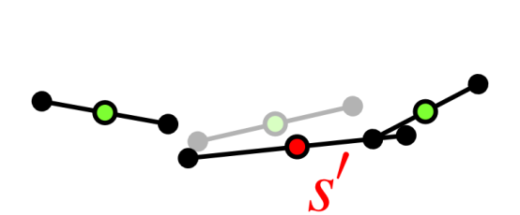
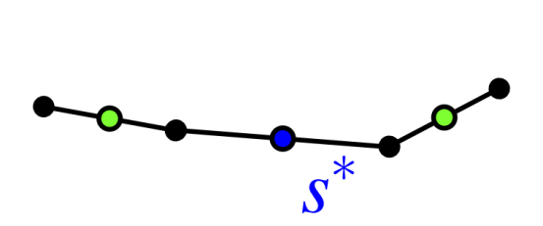
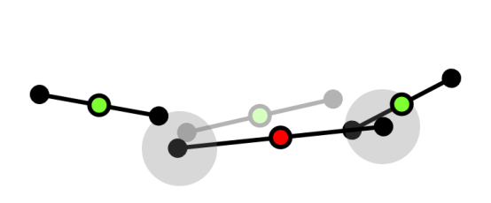
Delayed Rejection
Gives a second chance to a rejected configuration by enforcing the connectivity
Let s={s₁, s₂, s₃} be the current configuration
Propose a new configuration via affine transform kernel
If s’ is rejected, DR kernel searches for the nearest end points in the rest of the line segments
An alternative line segment s* will enforce the connectivity

Slide 18
Outline
Introduction
Marked Point Process modeling
MPP revisited
Generic model for curvilinear structures
Monte Carlo sampler with delayed rejection
Integration of line hypotheses
Experimental results
Summary

Slide 19
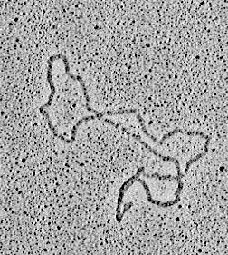
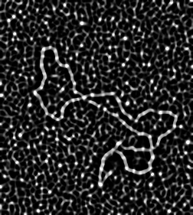
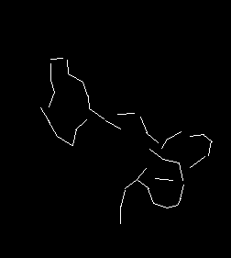
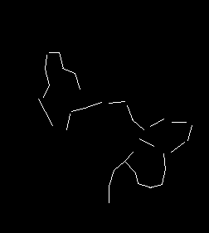
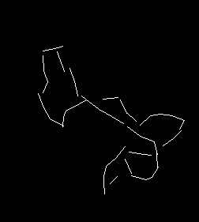



Create Line Hypotheses
MPP model is sensitive to the selection of hyperparameter
Learning is not feasible
Unable to obtain ground truth, e.g., wrinkles
Variable for different types of datasets
Input
Gradient

Slide 20
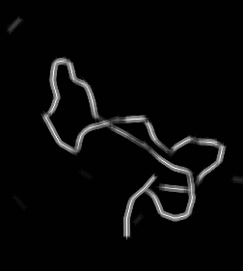

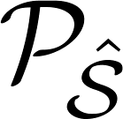
Integrate Line Hypotheses
Assumption
Prominent line segment will be observed more frequently
Mixture density
Shows consensus between line hypotheses
Criterion for hyperparameter vector selection
Input
Gradient

Slide 21
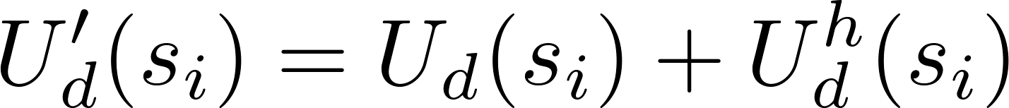
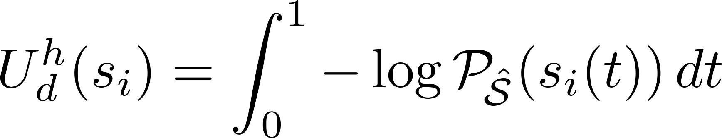

Integrate Line Hypotheses
Updated data likelihood
Reduce sampling space
Quantifies consensus among line hypotheses w.r.t.
Input
Gradient

Slide 22
Outline
Introduction
Marked Point Process modeling
MPP revisited
Generic model for curvilinear structures
Monte Carlo sampler with delayed rejection
Integration of line hypotheses
Experimental results
Summary

Slide 23
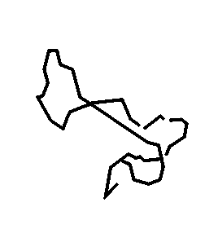
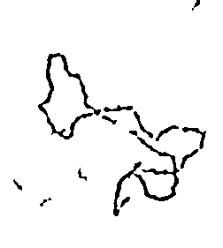
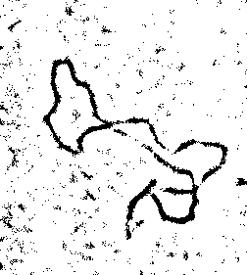
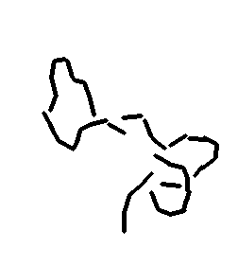
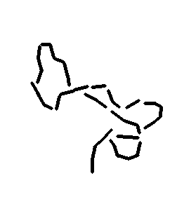






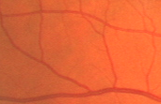
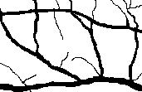
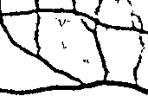
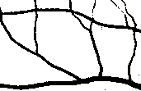


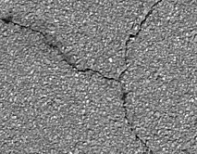
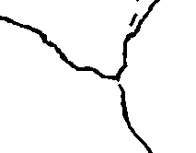

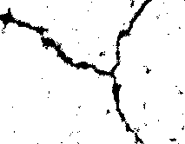
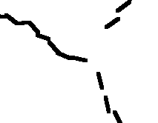
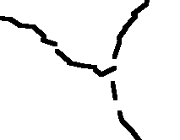
Experimental Results
Input
Ground truth
Path opening*
Learning**
Baseline MPP
Proposed
* H. Talbot et al., “Efficient complete and incomplete path openings and closings,” ICV 2007
** C. Becker et al., “Supervised feature learning for curvilinear structure segmentation,” MICCAI 2013

Slide 24




















Experimental Results
Input
Ground truth
Path opening*
Learning**
Baseline MPP
Proposed
* H. Talbot et al., “Efficient complete and incomplete path openings and closings,” ICV 2007
** C. Becker et al., “Supervised feature learning for curvilinear structure segmentation,” MICCAI 2013

Slide 25
















Experimental Results: missing
Input
Ground truth
Path opening*
Learning**
Baseline MPP
Proposed
* H. Talbot et al., “Efficient complete and incomplete path openings and closings,” ICV 2007
** C. Becker et al., “Supervised feature learning for curvilinear structure segmentation,” MICCAI 2013

Slide 26
















Experimental Results: over detection
Input
Ground truth
Path opening*
Learning**
Baseline MPP
Proposed
* H. Talbot et al., “Efficient complete and incomplete path openings and closings,” ICV 2007
** C. Becker et al., “Supervised feature learning for curvilinear structure segmentation,” MICCAI 2013

Slide 27




Experimental Results: Precision-Recall
Pros: fully automatic
Cons: varying line width, congestion
DNA
Wrinkles
Retina
Cracks

Slide 28
Summary
Generic MPP model for curvilinear structures
Wrinkles, DNA filaments, road cracks, blood vessels, ...
Modeling
Line segment: length & orientation
Data term: image gradient intensity & orientation
Prior term: provide smoothly connected lines
Simulation: RJMCMC with delayed rejection
Reduce parameter dependencies of MPP modeling using hypotheses integration

Slide 29
Thank you!
Marked Point Process Model for Curvilinear Structures Extraction
Seong-Gyun JEONG, Yuliya TARABALKA,
and Josiane ZERUBIA
firstname.lastname@inria.fr
https://team.inria.fr/ayin/

