Slide 1
Serious Game
&
Interactive system

Slide 2
Part I
Serious Game

Slide 3
Definition
What is a Serious Game (SG) ?

Slide 4
Definition
What is a Serious Game (SG) ?
SG = a game designed for a primary purpose other than pure entertainment

Slide 5
Definition
What is a Serious Game (SG) ?
SG = a game designed for a primary purpose other than pure entertainment
What is a Game ?

Slide 6
Definition
What is a Serious Game (SG) ?
SG = a game designed for a primary purpose other than pure entertainment
What is a Game ?
Rules
Activity
Game =
Goal
Environment

Slide 7

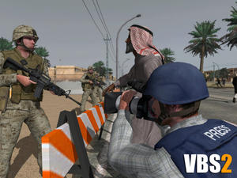

ExampleS
America’s Army
Domain : Defense
Goal : Communication
Type : 3D, muti-player

Slide 8

ExampleS

Slide 9


ExampleS
Renault Academy
Domain : Formation
Goal : training, simulation
Type : 3D

Slide 10

ExampleS

Slide 11


ExampleS
X-torp
Domain : Healthcare
Goal : Diagnostic, training
Type : 3D, muti-player

Slide 12

ExampleS

Slide 13
References
www.serious-game.fr/‎
wikipedia.org/wiki/Serious_game
serious.gameclassification.com/FR/

Slide 14
Part II
Interactive System

Slide 15
Context & problematics
Az@Game project
Serious Games for seniors suffering from Alzheimer's disease

Slide 16
Context & problematics
Az@Game project
Serious Games for seniors suffering from Alzheimer's disease
How to stimulate the patient to participate in a game round ?

Slide 17
Context & problematics
Az@Game project
Serious Games for seniors suffering from Alzheimer's disease
How to stimulate the patient to participate in a game round ?
How to provide an assistance of use during a game session ?

Slide 18
solution

Slide 19

solution

Slide 20
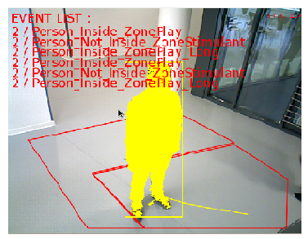
solution
Caméra RGB-D

Slide 21
solution
List
Recognized Events
Caméra RGB-D

Slide 22

solution
Caméra RGB-D
List
Recognized Events
Caméra RGB-D

Slide 23

solution
Caméra RGB-D
List
Recognized Events
Caméra RGB-D

Slide 24
solution
Caméra RGB-D
List
Recognized Events
Caméra RGB-D

Slide 25
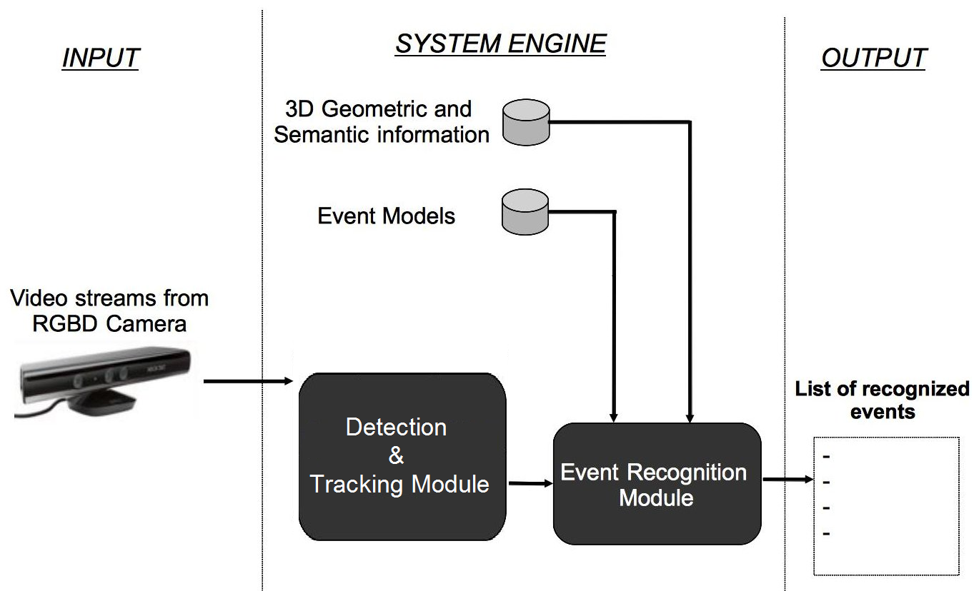
Details

Slide 26
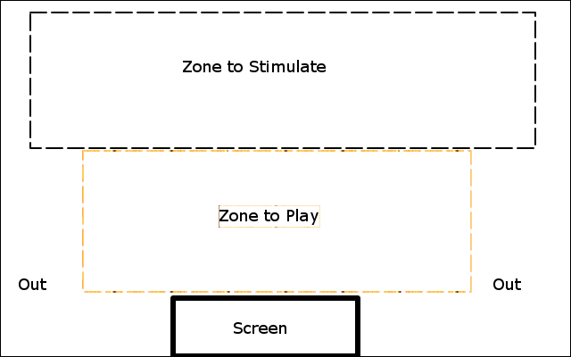
Details

Slide 27

Details

Slide 28
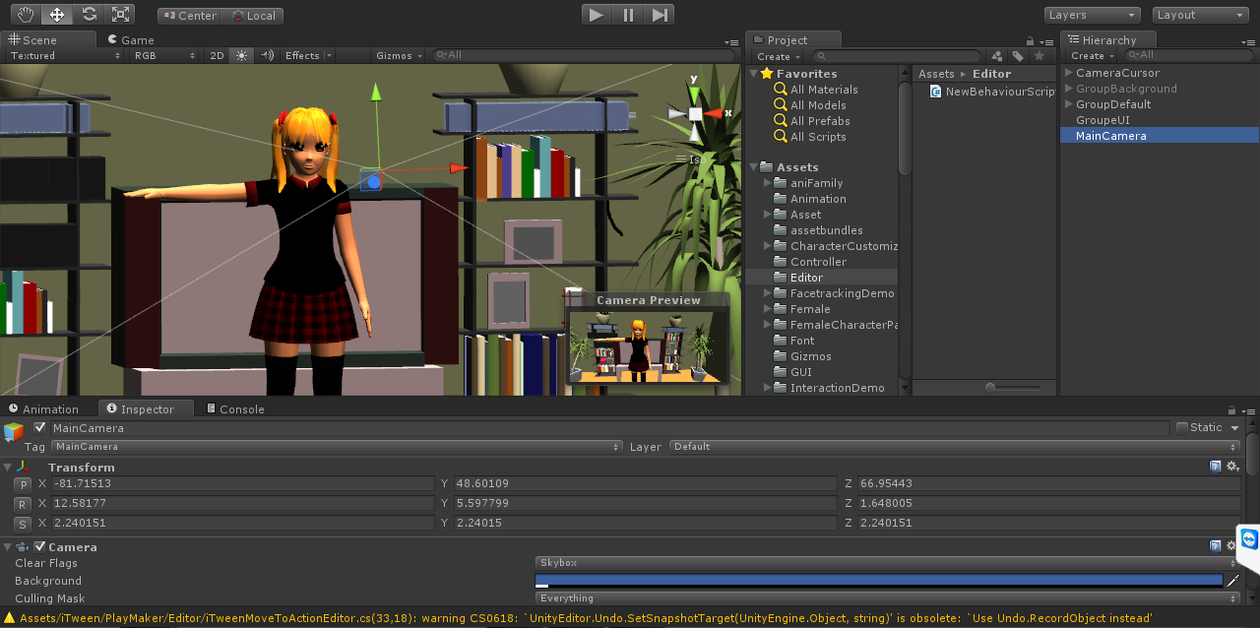
Details

Slide 29
Future Works
Integrate an identification module
Integrate a module of motion detection

