Slide 1
MACHINE LEARNING AND ARTIFICIAL NEURAL NETWORKS FOR FACE VERIFICATION
Alexis Zubiolo
Morpheme Team

Slide 2
Why do we need AI in Computer Vision?
The brain is really good at some pattern recognition tasks (e.g. face detection/verification)
But still, we have no idea how we ‘perform’ face detection, we are just good at it
Nowadays, it’s « easy » to gather a lot of data (internet, social networks, …), so we have a lot of training data available

Slide 3
Why neural networks?
The human vision system is the best we know
The brain has some interesting properties (low energy consumption, really quick for some vision tasks, …)

Slide 4
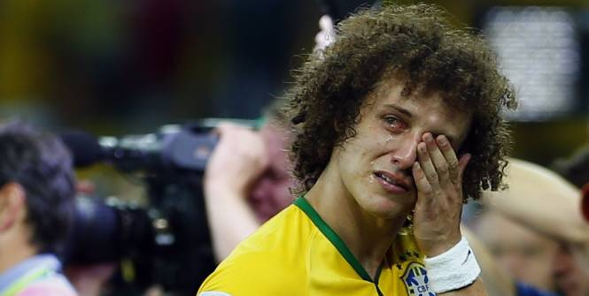
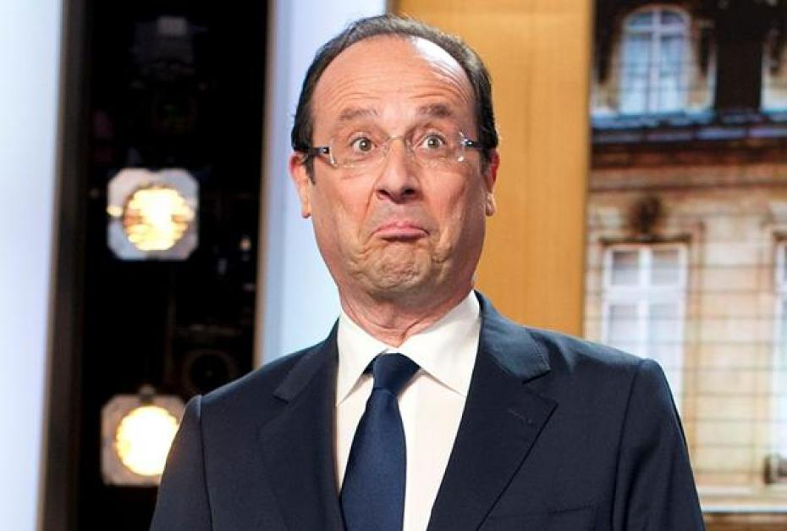
What to expect from an ANN?
It should be good at vision tasks
It should be bad at some other tasks
156 * 32 + 7853 = ?

Slide 5
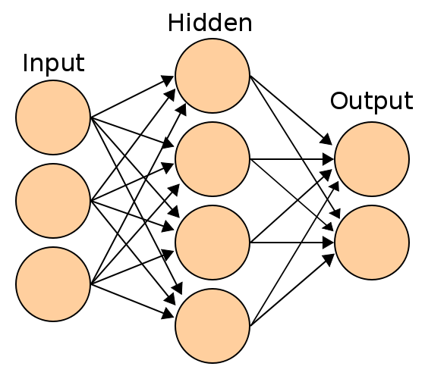
ANN: A (very, very) quick overview
3 types of layers (input, output and hidden)
Adaptive weights (i.e. numerical parameters tuned by a learning algorithm)

Slide 6
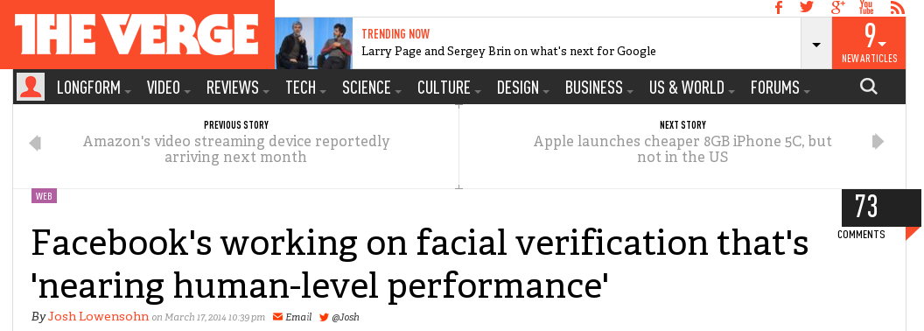
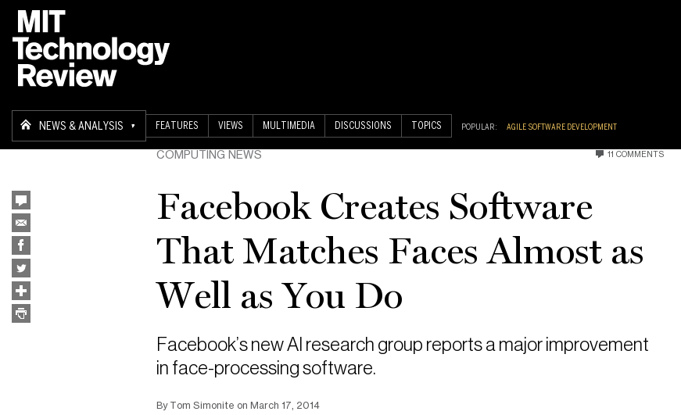
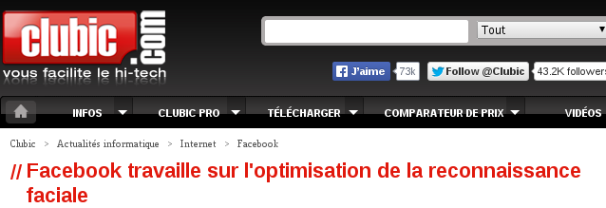
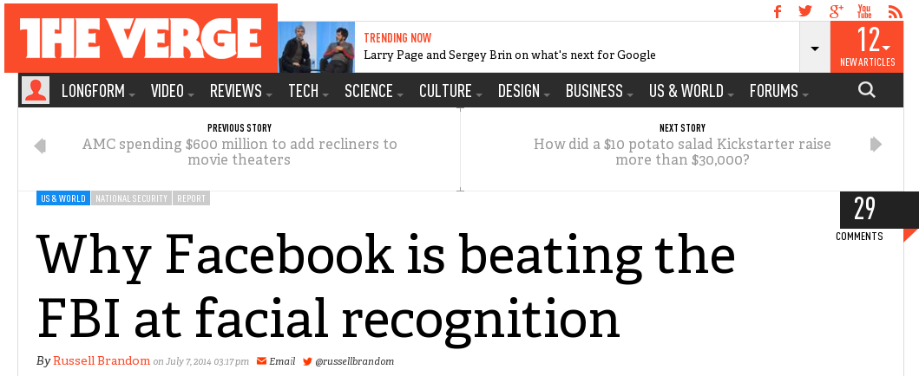
Application: DeepFace (CVPR ’14)

Slide 7
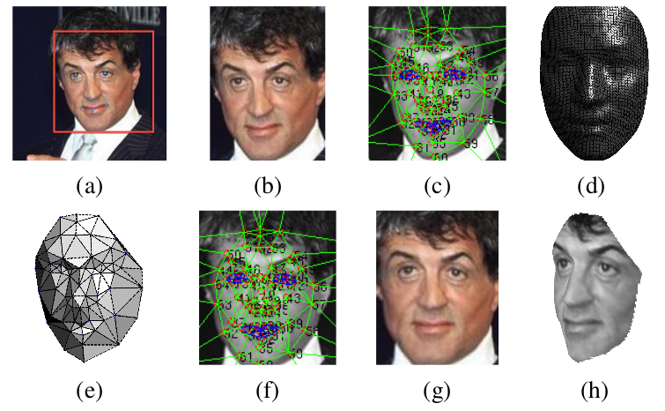
Pipeline of the method
1st step: Face Alignment

Slide 8
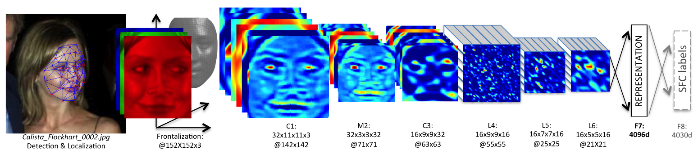
Pipeline of the method
2nd step: DNN Architecture and Training
C = Convolutional layer
M = Max-pooling layer (makes the output of convolutional networks more robust to translations)
L = Locally connected layer
F = Fully connected layer
More than 120M parameters to learn!

Slide 9
Tests on different datasets
3 different datasets have been used for testing:
Social Face Classification (SFC – 4,030 people with 800-1,200 faces each)
Labeled Faces in the Wild (LFW – 13,323 photos of 5,749 celebrities)
YouTube Faces (YTF – 3,425 YouTube videos of 1,595 subjects)

Slide 10
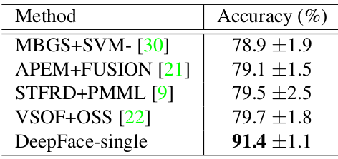
Results on the YTF dataset
Computational time: 0.33s per image (overall)
TL;DR: The method gives good results.

Slide 11
Open question
Can artificial neural networks be considered as the ‘ultimate’ AI/ML model?
Yes! Because human intelligence is considered as the best, so we have to get close to it
No! Because:
- the brain may be too complicated to ‘implement’ with the technology we have
- and…

Slide 12
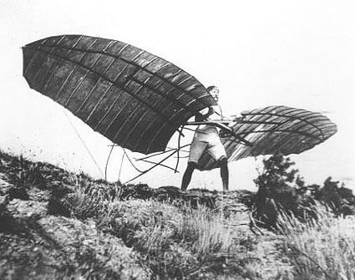
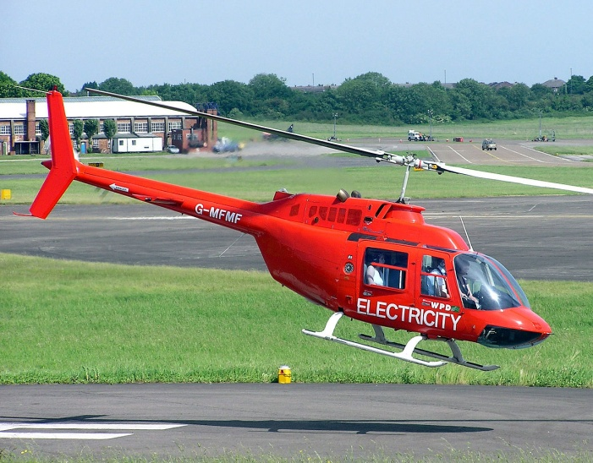
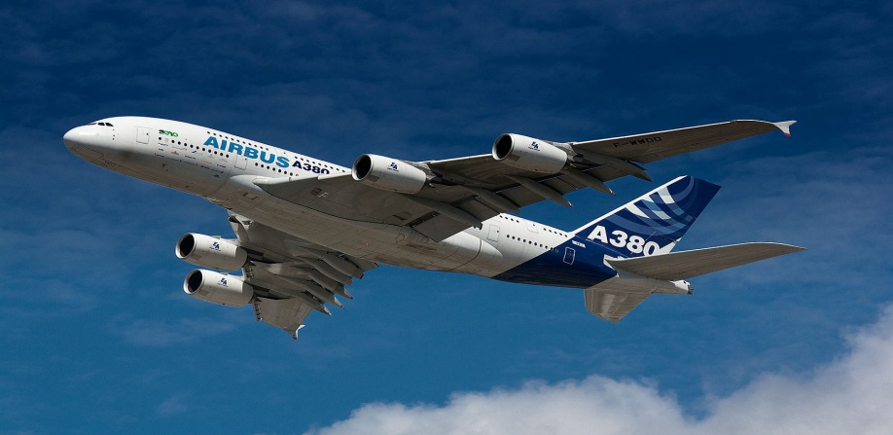
A classic comparison
A few centuries ago, the human wanted to fly…
So he looked at what was flying and tried to copy it.
But now, things have changed a bit…

Slide 13
Thank you! Any question?
Some useful links:
ML course: https://class.coursera.org/ml-005
ANN course: https://class.coursera.org/neuralnets-2012-001
DeepFace paper: https://www.facebook.com/publications/546316888800776/

