Slide 1
A true story of trees, forests
& papers
Journal club on Filter Forests for Learning Data-Dependent Convolutional Kernels, Fanello et al. (CVPR ’14)

Slide 2
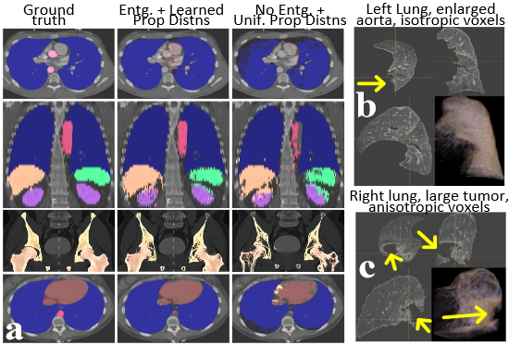
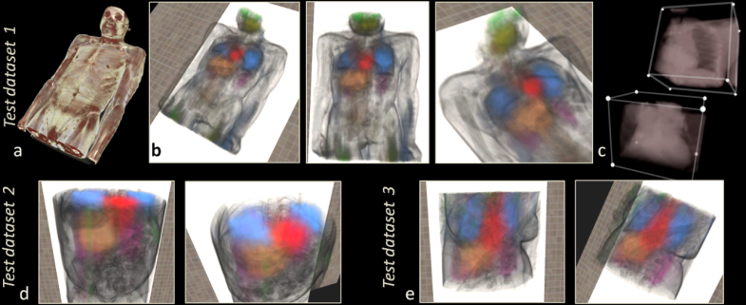
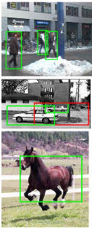
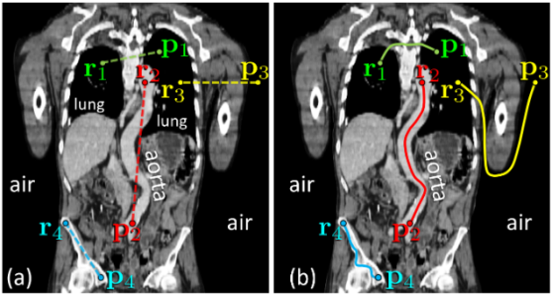

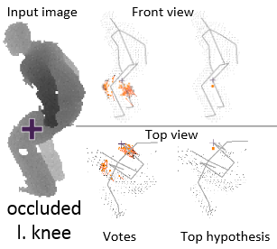
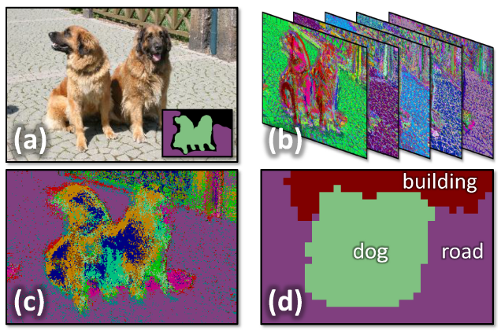
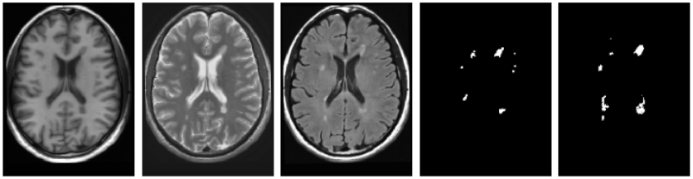
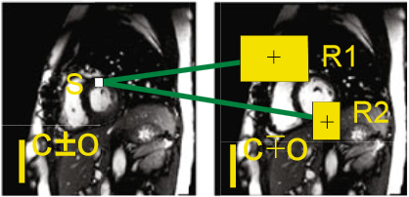
Criminisi et al. Organ localization w/ long-range spatial context (PMMIA 2009)
Miranda et al. I didn’t kill the old lady, she stumbled (Tumor segmentation in white, SIBGRAPI 2012)
Montillo et al. Entangled decision forests (PMMIA 2009)
Kontschieder et al. Geodesic Forests (CVPR 2013)
Shotton et al. Semantic texton forests (CVPR 2008)
Gall et al. Hough forests for object detection (2013)
Girshick et al. Regression of human pose,
but I’m not sure what this pose is about (ICCV 2011)
Geremia et al. Spatial decision forests for Multiple Sclerosis lesion segmentation (ICCV 2011)
Margeta et al. Spatio-temporal forests for LV segmentation (STACOM 2012)

Slide 3
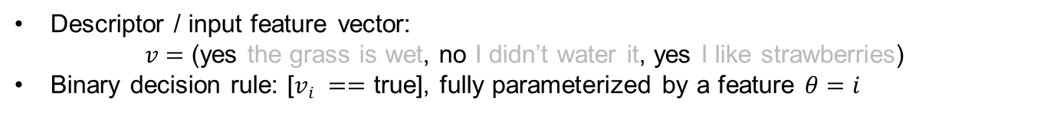
Decision tree:
Did it rain over the night? y/n
Is the grass wet?
Decision rules
Yes.
No.
Leaf model
Did you water the grass?
Yes.
No.
Y
N
Y
N
Y
N
Descriptor / input feature vector:
$v=$ (yes the grass is wet, no I didn’t water it, yes I like strawberries)
Binary decision rule: [$v_{i} ==$ true], fully parameterized by a feature $θ=i$

Slide 4
Decision tree:
Did it rain over the night? y/n
Do you like strawberries?
Yes.
No.
Y
N
Y
N
We want to select relevant decisions at each node, not silly ones like above
We define a criterion / cost function to optimize: the better the cost, the more the feature helps improve the final decision
In real applications the cost function measures performance w.r.t. a training dataset

Slide 5



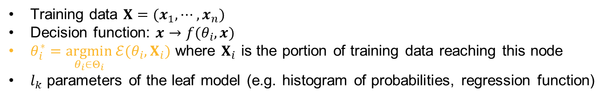




Decision tree:
Training phase
$$θ_{1}^{∗}$$
$$f\left(θ_{1}^{∗}, ⋅\right)≥0$$
$$f\left(θ_{1}^{∗}, ⋅\right)<0$$
$$θ_{2}^{∗}$$
$$l_{1}$$
$$l_{2}$$
$$l_{3}$$
Training data $X=(x_{1},⋯,x_{n})$
Decision function: $x→f(θ_{i},x)$
$θ_{i}^{∗}=\underset{θ_{i}∈Θ_{i}}{argmin}{ℰ(θ_{i},X_{i})}$ where $X_{i}$ is the portion of training data reaching this node
$l_{k}$ parameters of the leaf model (e.g. histogram of probabilities, regression function)

Slide 6



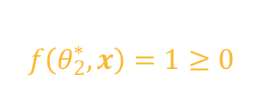




Decision tree:
Test phase
$$x$$
$$θ_{1}^{∗}$$
$$f\left(θ_{2}^{∗},x\right)=1≥0$$
$$f\left(θ_{1}^{∗},x\right)=3≥0$$
$$θ_{2}^{∗}$$
$$l_{1}$$
$$l_{2}$$
$$l_{3}$$
Use the leaf model $l_{2}$ to make your prediction for input point $x$

Slide 7
Decision tree:
Weak learners are cool

Slide 8

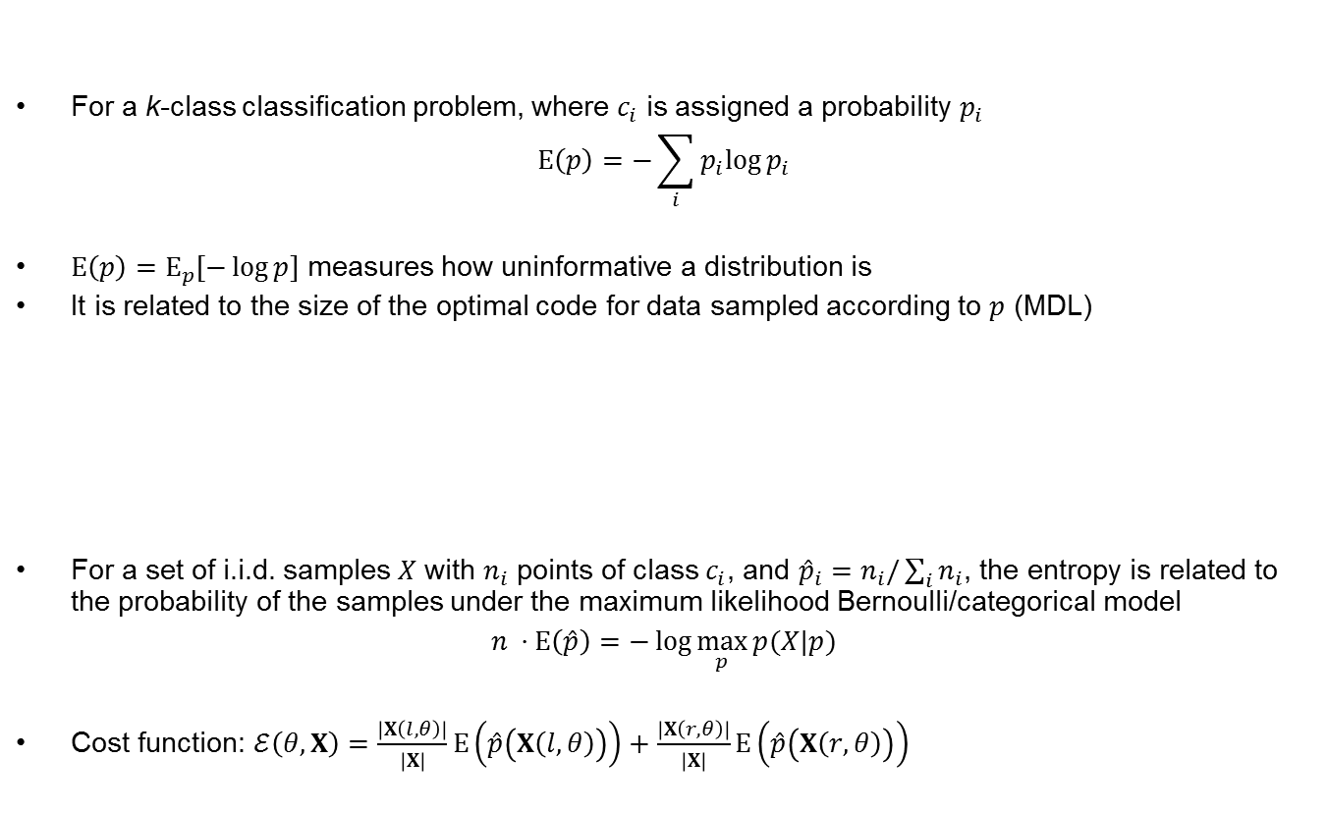

Decision tree:
Entropy – the classic cost function
For a k-class classification problem, where $c_{i}$ is assigned a probability $p_{i}$
$$Ε\left(p\right)=−\sum_{i}{p_{i}log{p_{i}}}$$
$Ε\left(p\right)=Ε_{p}[−\log{p}]$ measures how uninformative a distribution is
It is related to the size of the optimal code for data sampled according to $p$ (MDL)
For a set of i.i.d. samples $X$ with $n_{i}$ points of class $c_{i}$, and ${\hat{p}}_{i}=n_{i}/\sum_{i}{n_{i}}$, the entropy is related to the probability of the samples under the maximum likelihood Bernoulli/categorical model
$$n ⋅Ε\left(\hat{p}\right)=−\log{\max_{p}{p(X|p)}}$$
Cost function: $ℰ\left(θ,X\right)=\frac{\left|X\left(l,θ\right)\right|}{\left|X\right|}Ε\left(\hat{p}\left(X\left(l,θ\right)\right)\right)+\frac{\left|X\left(r,θ\right)\right|}{\left|X\right|}Ε\left(\hat{p}\left(X\left(r,θ\right)\right)\right)$
$$Ε=0$$
$$Ε=\log{2}$$
Y
N
Y
N

Slide 9


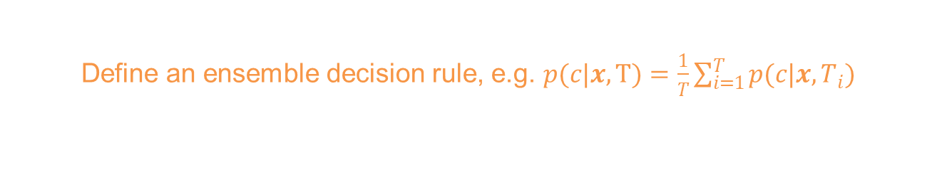


Random forest:
Ensemble of T decision trees
Train on subset $X_{1}$
Train on subset $X_{2}$
Train on subset $X_{T}$
$$⋯$$
Optimize over a subset of all the possible features
Define an ensemble decision rule, e.g. $p(c|x,Τ)=\frac{1}{T}\sum_{i=1}^{T}{p(c|x,T_{i})}$

Slide 10
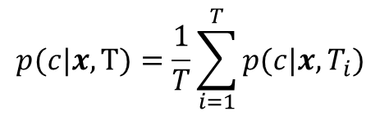
Decision forests:
Max-margin behaviour
$$p(c|x,Τ)=\frac{1}{T}\sum_{i=1}^{T}{p(c|x,T_{i})}$$

Slide 11
A quick, dirty and totally accurate story of trees & forests
Same same
  CART a.k.a. Classification and Regression Trees (generic term for ensemble tree models)
  Random Forests (Breiman)
  Decision Forests (Microsoft)
  XXX Forests, where XXX sounds cool (Microsoft or you, to be accepted at the next big conference)
Quick history
  Decision tree: some time before I was born?
  Amit and Geman (1997): randomized subset of features for a single decision tree
  Breiman (1996, 2001): Random Forest(tm)
    Boostrap aggregating (bagging): random subset of data training points at each node
    Theoretical bounds on the generalization error, out-of-bag empirical estimates
  Decision forests: same thing, terminology popularized by Microsoft
    Probably motivated by Kinect (2010)
    A good overview by Criminisi and Shotton: Decision forests for Computer Vision and Medical Image Analysis (Springer 2013)
    Active research on forests with spatial regularization: entangled forests, geodesic forests
For people who think they are probably somewhat bayesian-inclined a priori
  Chipman et al. (1998): Bayesian CART model search
  Chipman et al. (2007): Bayesian Ensemble Learning (BART)

Slide 12
Fanello et al. Filter Forests for Learning Data-Dependent Convolutional Kernels (CVPR 2014)
Application to image/signal denoising

Slide 13
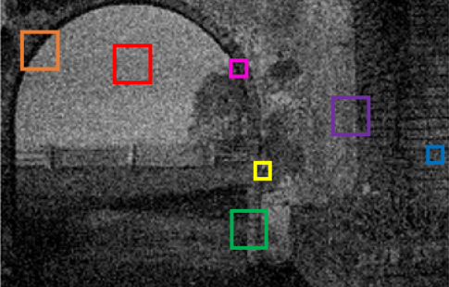
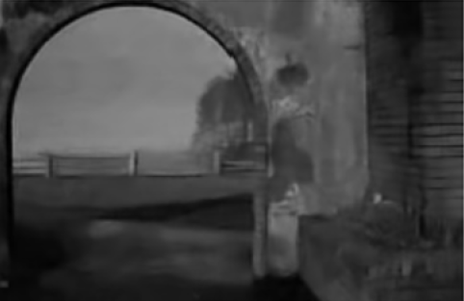
Image restoration:
A regression task
Noisy image
Denoised image
Infer « true » pixel values using context (patch) information

Slide 14
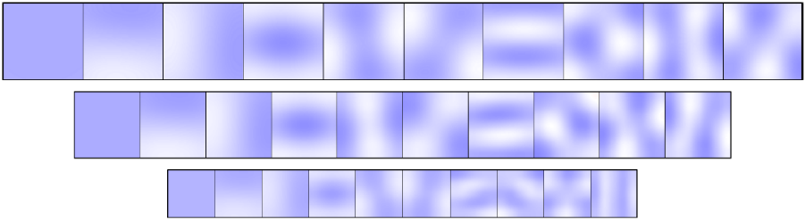

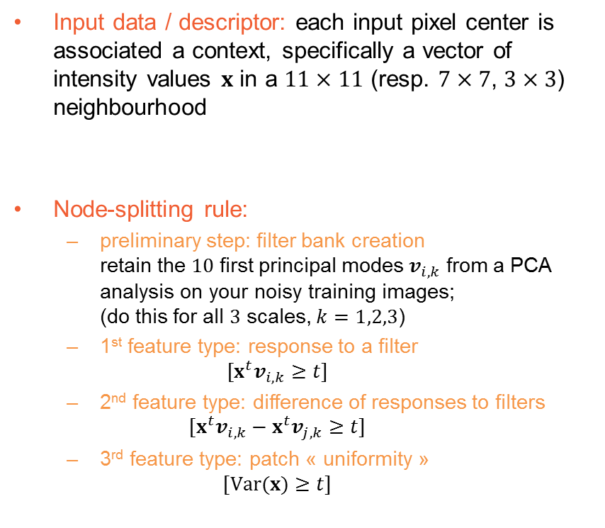
Filter Forests:
Model specification
Input data / descriptor: each input pixel center is associated a context, specifically a vector of intensity values $x$ in a $11×11$ (resp. $7×7$, $3×3$) neighbourhood
Node-splitting rule:
  preliminary step: filter bank creation
  retain the $10$ first principal modes $v_{i,k}$ from a PCA analysis on your noisy training images;
  (do this for all $3$ scales, $k=1,2,3$)
  1st feature type: response to a filter
  $[x^{t}v_{i,k}≥t]$
  2nd feature type: difference of responses to filters
  $[x^{t}v_{i,k}−x^{t}v_{j,k}≥t]$
  3rd feature type: patch « uniformity »
  $$[Var(x)≥t]$$
$$x=(x_{1},⋯, x_{p^{2}})$$

Slide 15
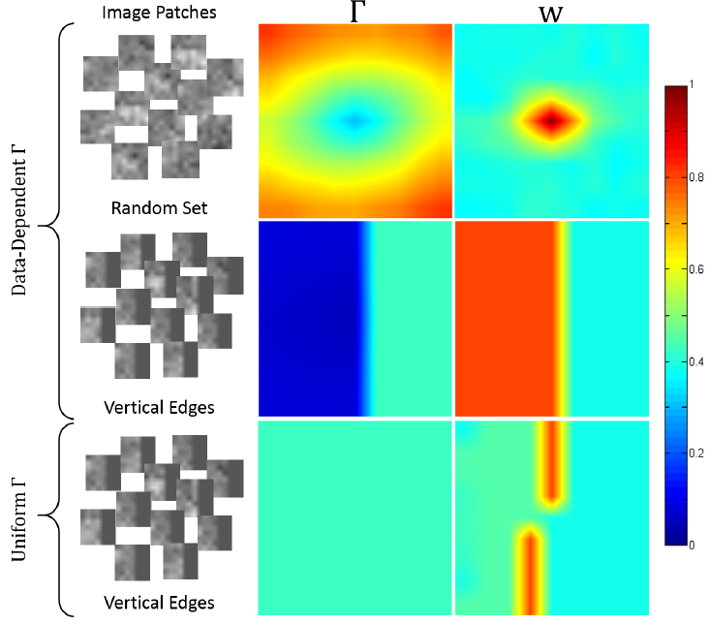

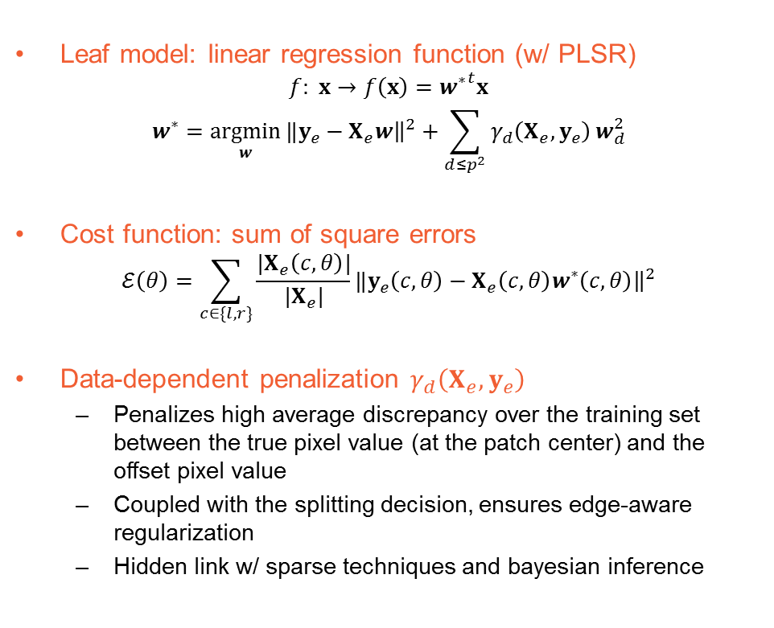

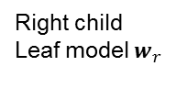
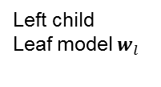
Filter Forests:
Model specification
$$x=(x_{1},⋯, x_{p^{2}})$$
Leaf model: linear regression function (w/ PLSR)
$$f: x→f\left(x\right)={w^{∗}}^{t}x$$
$$w^{∗}=\underset{w}{argmin}{‖y_{e}−X_{e}w{\left.​\right\|}^{2}+\sum_{d≤p^{2}}{γ_{d}\left(X_{e},y_{e}\right)}w_{d}^{2}}$$
Cost function: sum of square errors
$$ℰ\left(θ\right)=\sum_{c∈\{l,r\}}{\frac{|X_{e}\left(c,θ\right)|}{|X_{e}|}‖y_{e}\left(c,θ\right)−X_{e}\left(c,θ\right)w^{∗}\left(c,θ\right){\left.​\right\|}^{2}}$$
Data-dependent penalization $γ_{d}\left(X_{e},y_{e}\right)$
  Penalizes high average discrepancy over the training set between the true pixel value (at the patch center) and the offset pixel value
  Coupled with the splitting decision, ensures edge-aware regularization
  Hidden link w/ sparse techniques and bayesian inference
Feature $θ$
Left child
Leaf model $w_{l}$
Right child
Leaf model $w_{r}$

Slide 16

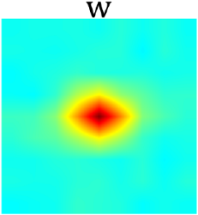

Filter Forests:
Summary
Input
$$x=(x_{1},⋯, x_{p^{2}})$$
PCA based split rule
Edge-aware convolution filter

Slide 17
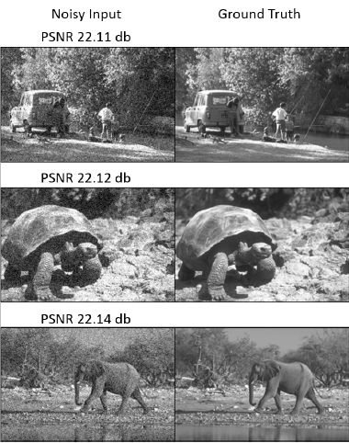
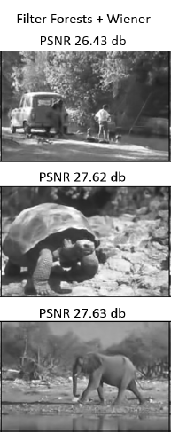
Dataset on which they perform better than the others

Slide 18
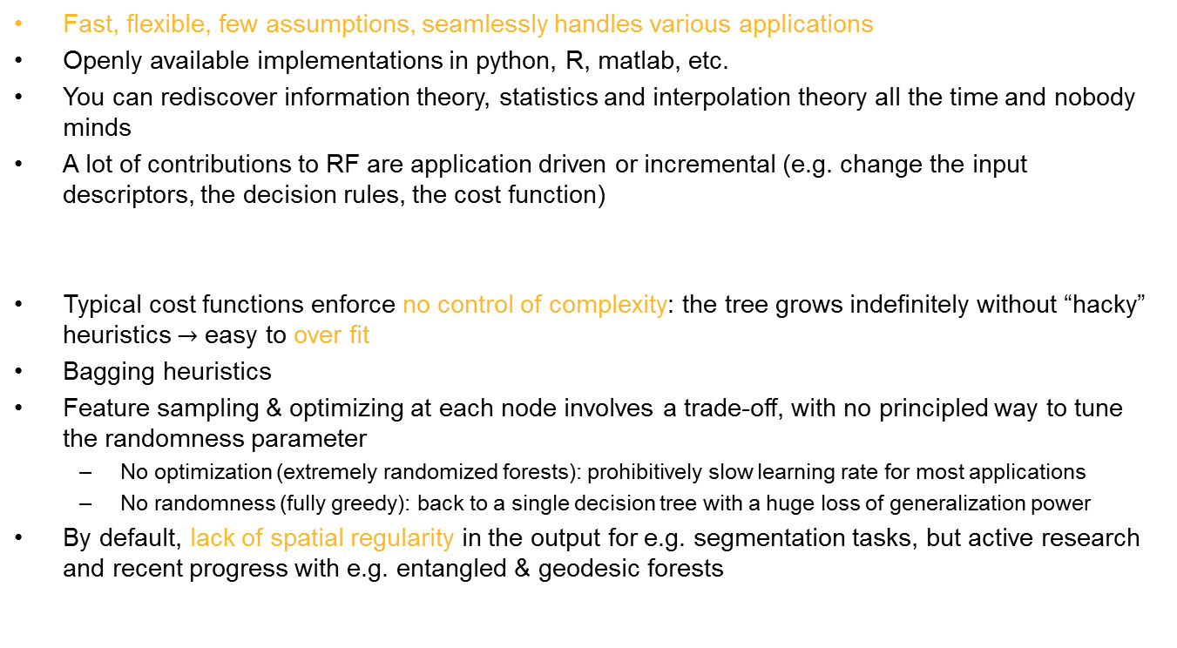
Cool & not so cool stuff about decision forests
Fast, flexible, few assumptions, seamlessly handles various applications
Openly available implementations in python, R, matlab, etc.
You can rediscover information theory, statistics and interpolation theory all the time and nobody minds
A lot of contributions to RF are application driven or incremental (e.g. change the input descriptors, the decision rules, the cost function)
Typical cost functions enforce no control of complexity: the tree grows indefinitely without “hacky” heuristics $→$ easy to over fit
Bagging heuristics
Feature sampling & optimizing at each node involves a trade-off, with no principled way to tune the randomness parameter
  No optimization (extremely randomized forests): prohibitively slow learning rate for most applications
  No randomness (fully greedy): back to a single decision tree with a huge loss of generalization power
By default, lack of spatial regularity in the output for e.g. segmentation tasks, but active research and recent progress with e.g. entangled & geodesic forests

Slide 19
Thank you.
The End \o/

