Slide 1
Serious Game & Interactive system

Slide 2
Part I Serious Game

Slide 3
Definition What is a Serious Game (SG) ?

Slide 4
Definition What is a Serious Game (SG) ?
SG = a game designed for a primary purpose other than pure entertainment

Slide 5
Definition What is a Serious Game (SG) ?
SG = a game designed for a primary purpose other than pure entertainment
What is a Game ?

Slide 6
Definition What is a Serious Game (SG) ?
SG = a game designed for a primary purpose other than pure entertainment
What is a Game ?
Rules
Activity
Game =
Goal
Environment

Slide 7
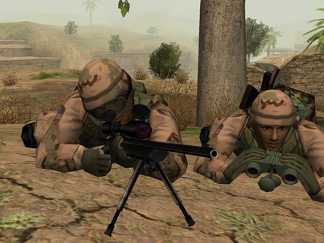
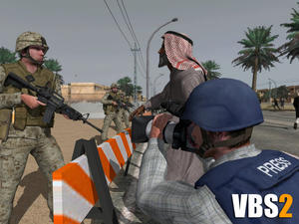
ExampleS
America’s Army
Domain : Defense
Goal : Communication
Type : 3D, muti-player

Slide 8
ExampleS

Slide 9
ExampleS
Renault Academy
Domain : Formation
Goal : training, simulation
Type : 3D

Slide 10
ExampleS

Slide 11
ExampleS
X-torp
Domain : Healthcare
Goal : Diagnostic, training
Type : 3D, muti-player

Slide 12
ExampleS

Slide 13
References
www.serious-game.fr/‎
wikipedia.org/wiki/Serious_game
serious.gameclassification.com/FR/

Slide 14
Part II Interactive System

Slide 15
Context & problematics
Az@Game project
Serious Games for seniors suffering from Alzheimer's disease

Slide 16
Context & problematics
Az@Game project
Serious Games for seniors suffering from Alzheimer's disease
How to stimulate the patient to participate in a game round ?

Slide 17
Context & problematics
Az@Game project
Serious Games for seniors suffering from Alzheimer's disease
How to stimulate the patient to participate in a game round ?
How to provide an assistance of use during a game session ?

Slide 18
solution

Slide 19
solution

Slide 20
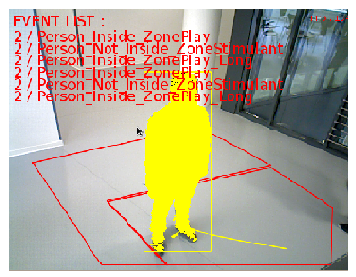
solution
Caméra RGB-D

Slide 21
solution
List
Recognized Events
Caméra RGB-D

Slide 22
solution
Caméra RGB-D
List
Recognized Events
Caméra RGB-D

Slide 23
solution
Caméra RGB-D
List
Recognized Events
Caméra RGB-D

Slide 24
solution
Caméra RGB-D
List
Recognized Events
Caméra RGB-D

Slide 25
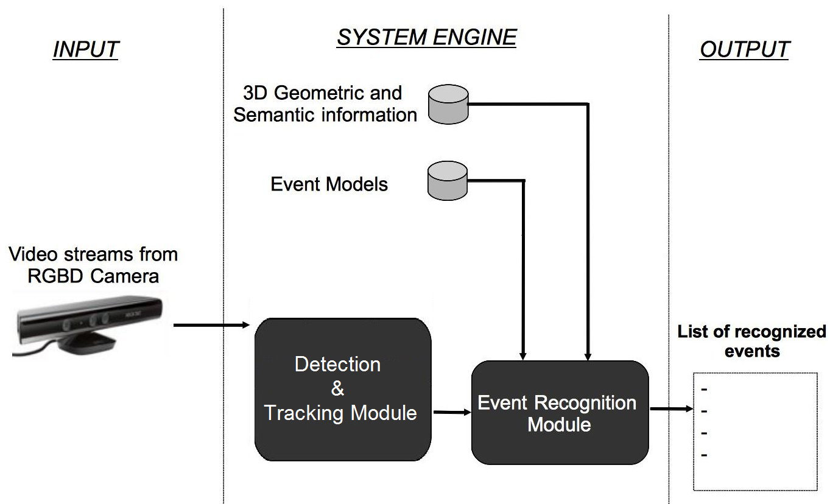
Details

Slide 26
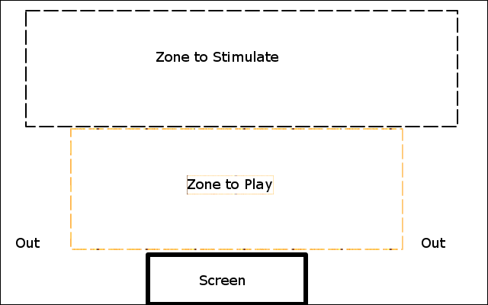
Details

Slide 27
Details

Slide 28
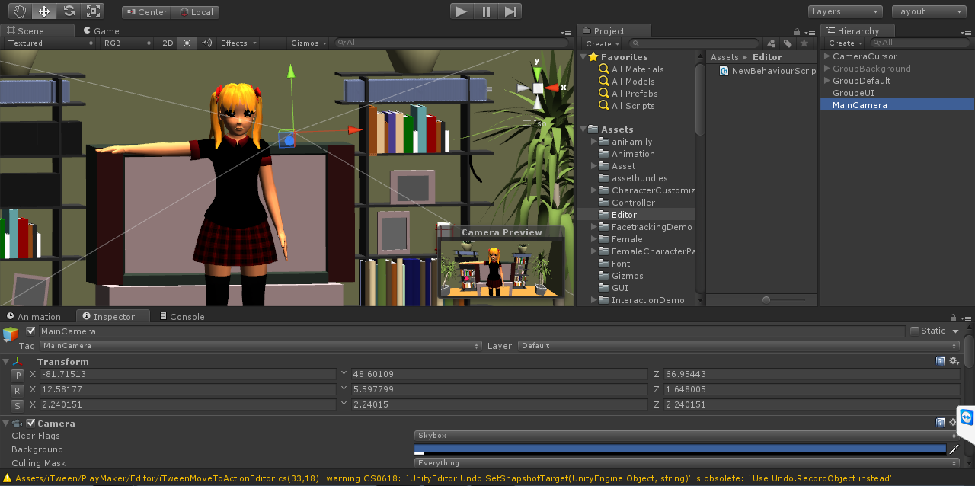
Details

Slide 29
Future Works
Integrate an identification module
Integrate a module of motion detection

